Slide 1
2017 Dutch General Elections
Ilse van Beelen and Floor Komen | Leiden

Slide 2

Index
Introduction & data sampling
Data cleaning
Data visualisation
CDA
GroenLinks
Formulate model
CDA
GroenLinks
Final model
Discussion & cross-validation

Slide 3
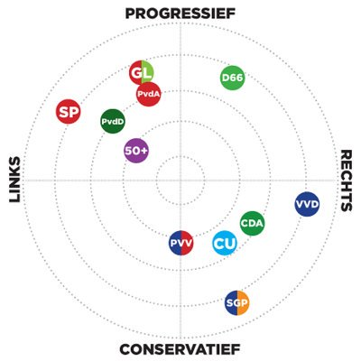
Introduction & data sampling
What is the influence of demographics of a municipality on who the residents voted for during the 2017 general election in the Netherlands?
Data Sampling
Parties to research: CDA and GroenLinks
Two different parties
Not to extreme
Demographics: Amount of 60+ residents, Non-west residents,
mean income, highly educated residents
Influence on a municipality level

Slide 4

Data cleaning
From different .csv files to a data.frame
Difference in names and formats made it sometimes hard
to combine them
Municipalities deleted: Caribbean Islands and Boxmeer
Parties:
Absolute amount of votes changed to percentages
Parties with no seat in the House of Representatives deleted

Slide 5
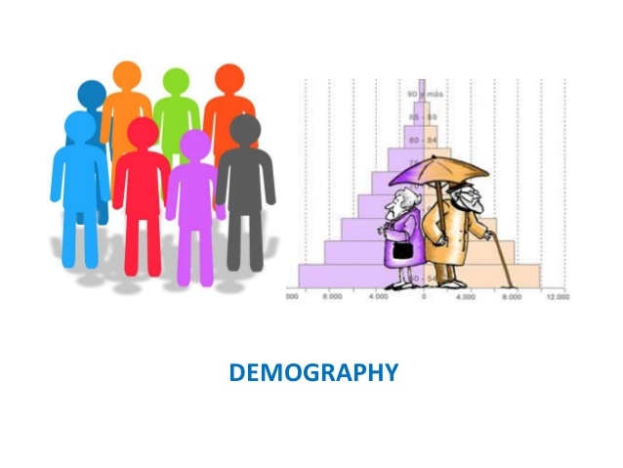
Data cleaning
Demographics:
Urban index:
Raw data: 5 categories, per category amount of km
Clean data: Index number, weighed on population
Non west factor:
Raw data: Am0unt of non-western residents
Clean data: Factor, Municipalities with <5%, 5%-10%, >10%. Factor because otherwise to many points with to much leverage.
Perc. 60+
Standardized mean income
Perc. Highly educated

Slide 6
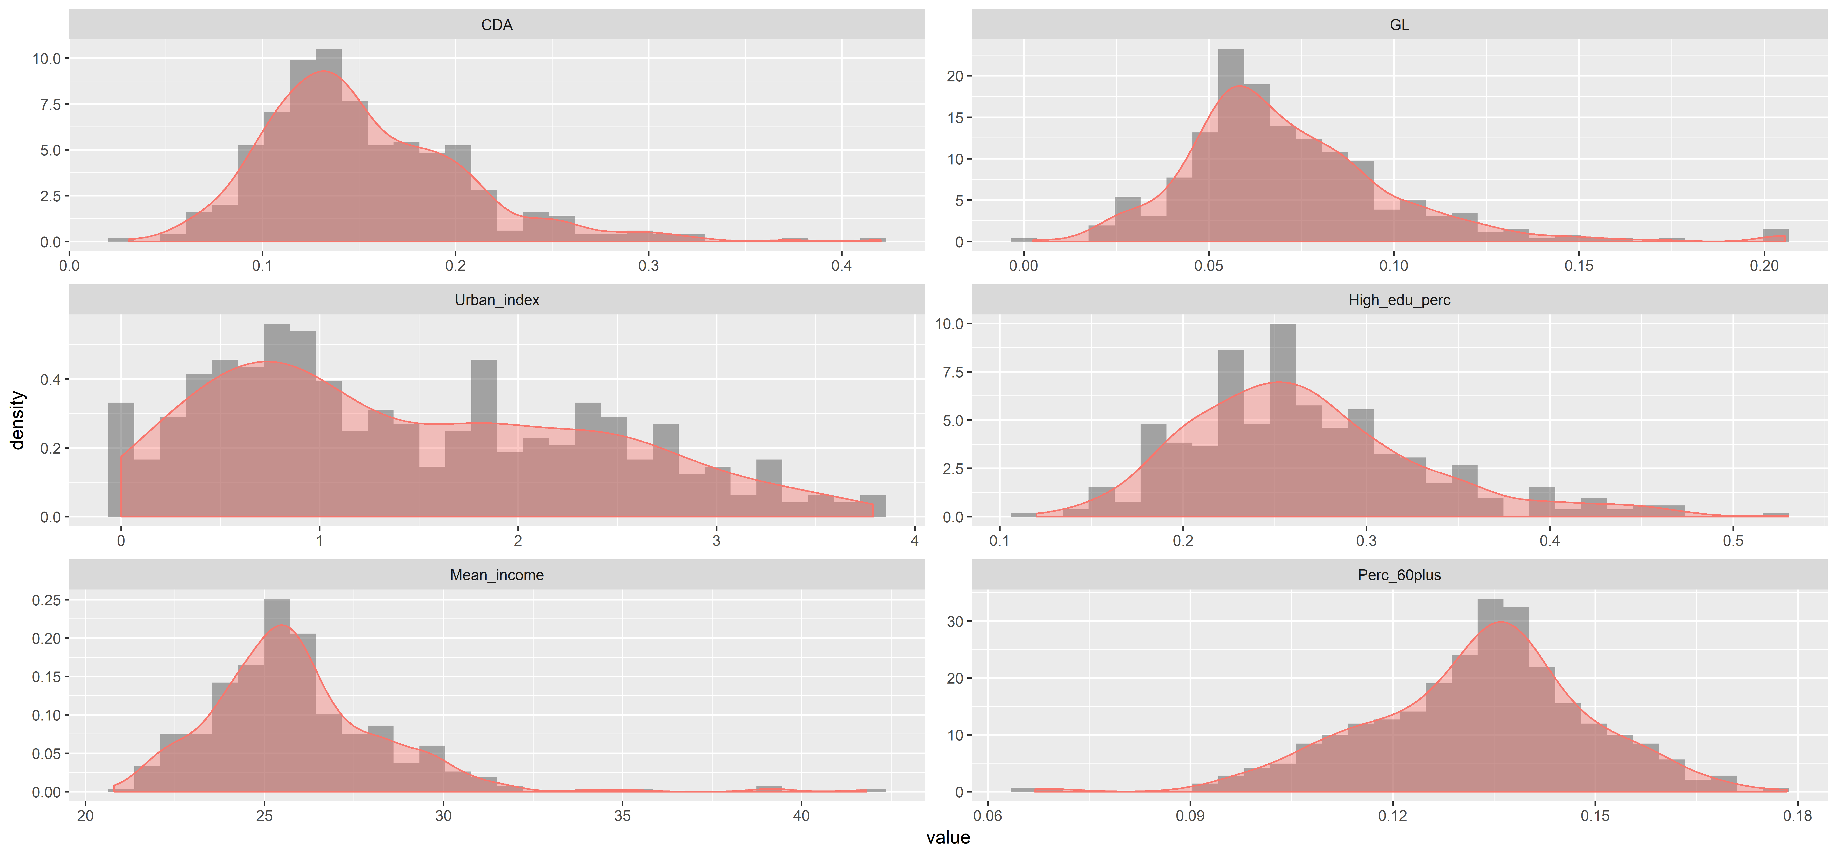
Data visualisation: Density plot

Slide 7
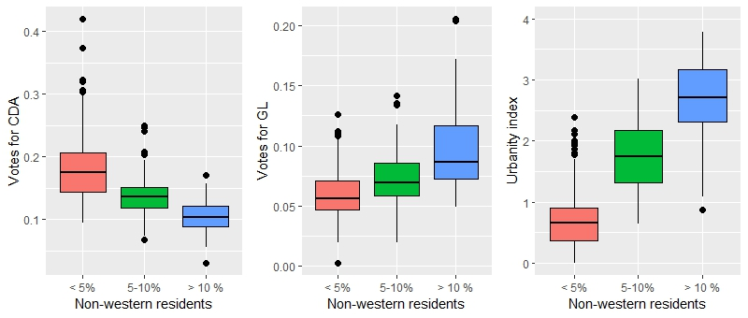
Data visualisation: Boxplots

Slide 8
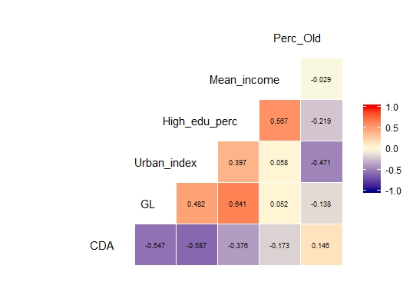
Data visualisation: Heatmap

Slide 9
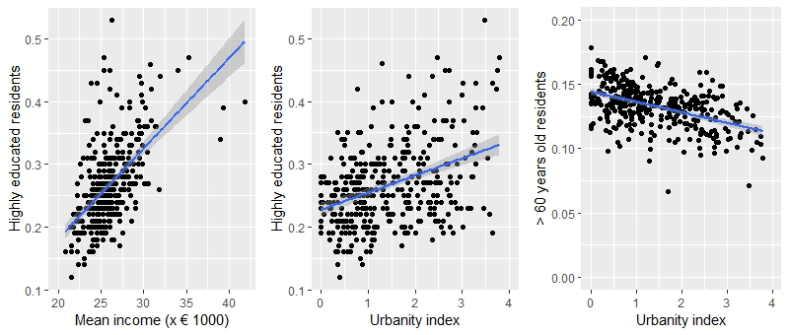
Data visualisation: Scatterplots

Slide 10
Formulate model
GLM binomial
Response variable is fraction
Logit as link function
Model : CDA ~ Intercept + Urbanity index + Highly educated + Fraction 60plus + Non western
Model: GL ~ Intercept + Highly educated + Mean income+ Fraction 60plus + Non western

Slide 11
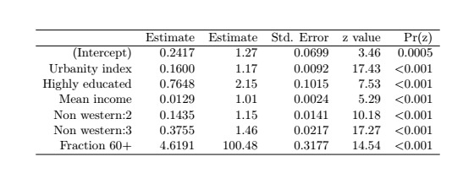
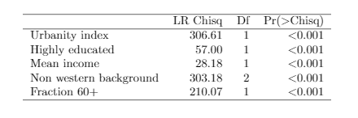
Formulate model CDA
Model : CDA ~ Intercept + Urbanity index + Highly educated + Mean income + Fraction 60plus + Non western
AIC = 6557.7
Null deviance: 7653.4
Residual deviance: 4093.1
Model summary
Anova table

Slide 12
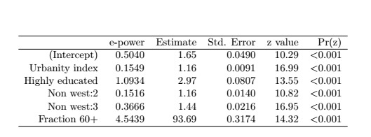
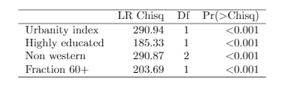
Final model CDA
Model: CDA ~ Intercept + Urbanity index + Highly educated + Fraction 60plus + Non western
AIC = 6583.9
Null deviance: 7653.4
Residual deviance: 4121.3
Model summary
Anova table

Slide 13
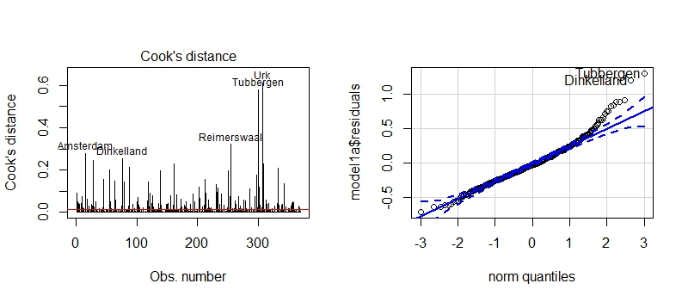
Assumptions

Slide 14
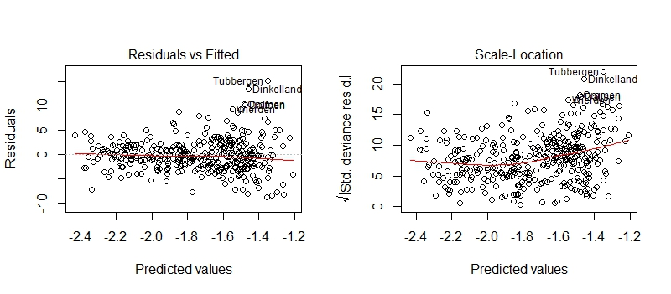
Assumptions

Slide 15
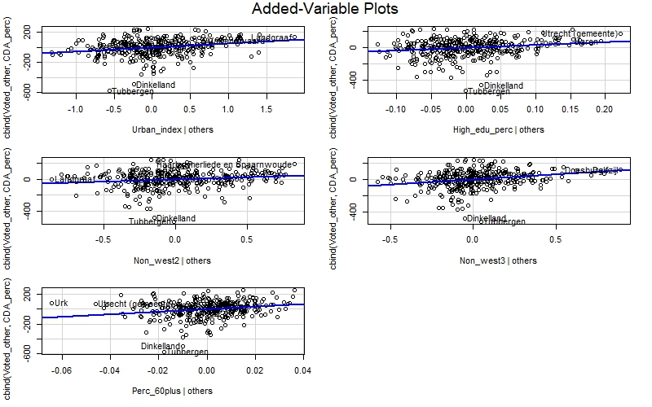
Added variable plots

Slide 16
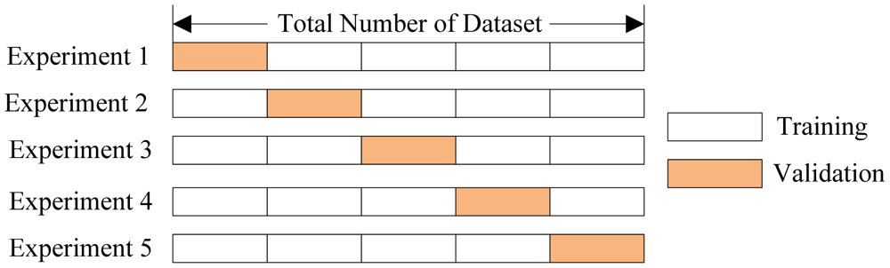
Cross validation
Model : CDA ~ Intercept + Urbanity index + Highly educated + Fraction 60plus + Non western
Model: GL ~ Intercept + Highly educated + Mean income+ Fraction 60plus + Non western
5-fold
Percentage of variance explained:
CDA 48.9 %
GL 73.7 %

Slide 17
Conclusions
Netherlands has 13 parties
We can not draw hard conclusions about the voting trends based on demoographics
Lot of small municipalities with high influence

Slide 18
Any questions?

Slide 19
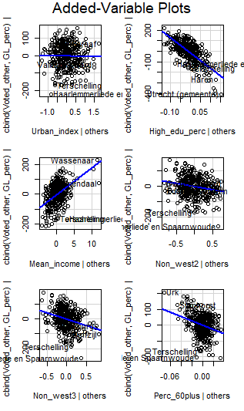
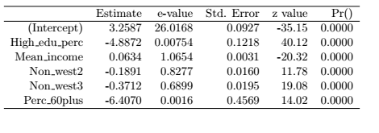
Formulate model GroenLinks
Model 1: GL ~ Intercept + Urban_index + High_edu_perc + Mean_income+ Perc_60plus + Non_west
AIC: 3842
Null deviance: 4428
Residual deviance: 1634
Added-Variable Plots
Model summary

Slide 20
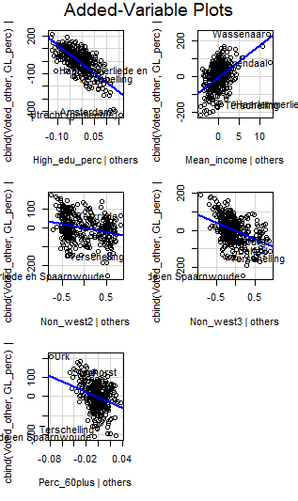
Formulate model GroenLinks
Model 2: GL ~ Intercept + High_edu_perc + Mean_income+ Perc_60plus + Non_west
AIC: 3841.8
Null deviance: 4428
Residual deviance: 1633.8
Added-Variable Plots
Model summary

